Slide 1
M13 - JQuery

Slide 2
Outline
Core
Syntax
Selectors
Attributes
Events
Effects
Chaining
DOM Manipulation
Traversing
Ajax

Slide 3
Core
A brief background on jQuery

Slide 4
INTRODUCTION
Created by John Resig in 2006
Write less, Do More
fast, small, and feature-rich JavaScript library
simplifies document traversal and manipulation, event handling, animation, and Ajax
easy-to-use API that works across a multitude of browsers

Slide 5
Before the jump
Valid XHTML/HTML/HTML5
CSS 2.1 / CSS 3
Basic JavaScript
Document Object Model (DOM)

Slide 6
Setting Up jQuery
Download
https://jquery.com/download/
CDN
<script type = "text/javascript" src = "http://ajax.googleapis.com/ajax/libs/jquery/2.1.3/jquery.min.js"></script>
Include in head section of DOM
Add before other jQuery Plugins

Slide 7
Syntax
How to write jQuery

Slide 8
Syntax
$(selector).action()
HTML element to be manipulated
The process to be done to the selected element.

Slide 9
Selectors

Slide 10
Selectors
Returns an array of DOM objects
Case-Sensitive
Chaining and Callback

Slide 11
Selectors
HTML code
How to Select
<div id="index" class="page">
<div id="top" class="header">
<p>Welcome Trainees</p>
</div>
</div>
Element
$(‘div’), $(‘p’)
ID
$(‘#index’), $(‘div#index’)
Class
$(‘.page’), $(‘div.page’)
Multiple
$(‘#index, #top’ )
Universal
$(‘*’)
Notes:
4. Multiple
- ‘#index, #top’ vs. ‘#index #top’

Slide 12
Attributes

Slide 13
Attributes
DOM Properties
Example:
<div id="index" class="page"></div>
<a class="link" href="link.html" title="Link to link.html">Click Me</a>
<div> attributes:
- id, class
<a> attributes:
- class, href, title

Slide 14
Attributes
.attr()
Allows manipulation of attributes.
Example:
<div id="index" class="page"></div>
Selecting an attribute: $(‘#index’).attr(‘class’);
Setting an attribute’s value: $(‘#index’).attr(‘class’, ‘className’);
Setting Multiple attributes:
$(‘#index’).attr({
‘class’:‘className’,
‘style’:‘background-color:#000’
});

Slide 15
Attributes
addClass() – adds a class attribute
$(‘#index’).addClass(‘className’);
hasClass() – checks if an element contains a class
$(‘#index’).hasClass(‘className’);
val() – returns the value of an input tag (except radio and checkboxes)
Retrieve: $(‘input#name’).val()
Set: $(‘input#name’).val(‘New Value’)
removeAttr() – removes an attribute
$(‘a.link’).removeAttr(‘title’);

Slide 16
Events

Slide 17
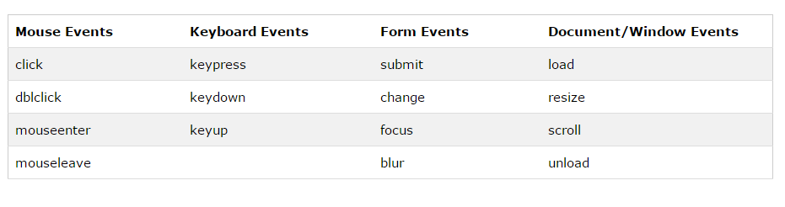
Events
precise moment when something happens
CASE-SENSITIVE

Slide 18
Effects

Slide 19
Effects
Hide/Show Effects
hide()
show()
Syntax:
$(selector).effect(speed, [callback]);

Slide 20
Effects
Fade Effects
fadeIn()
fadeOut()
fadeToggle()
fadeTo()
Syntax:
$(selector).effect(speed, callback);
fadeTo: $(selector).effect(speed, opacity, [callback]);

Slide 21
Effects
Slide Effects:
slideDown()
slideUp()
slideToggle()
Syntax:
$(selector).effect(speed, [callback]);

Slide 22
Effects
Animate
$(selector).animate({params}, speed, callback);
http://www.w3schools.com/jquery/jquery_animate.asp
Stop
$(selector).stop(stopAll, goToEnd);

Slide 23
Chaining

Slide 24
Chaining
$("#p1").css("color", "red").slideUp(2000).slideDown(2000);

Slide 25
DOM Manipulation

Slide 26
DOM Manipulation
text() – set/get the text content of the selected element/s
html() – set/get the whole content of the selected element/s
val() – set/get the value of an input field
attr()

Slide 27
Adding Contents
append() - inserts content at the end of the selected elements
prepend() - inserts content at the beginning of the selected elements
after() - inserts content after the selected elements
before() - inserts content before the selected elements

Slide 28
Manipulating CSS
addClass() - adds one or more classes to the selected elements
removeClass() - removes one or more classes from the selected elements
toggleClass() - toggles between adding/removing classes from the selected elements
css() – set/get the style attribute

Slide 29
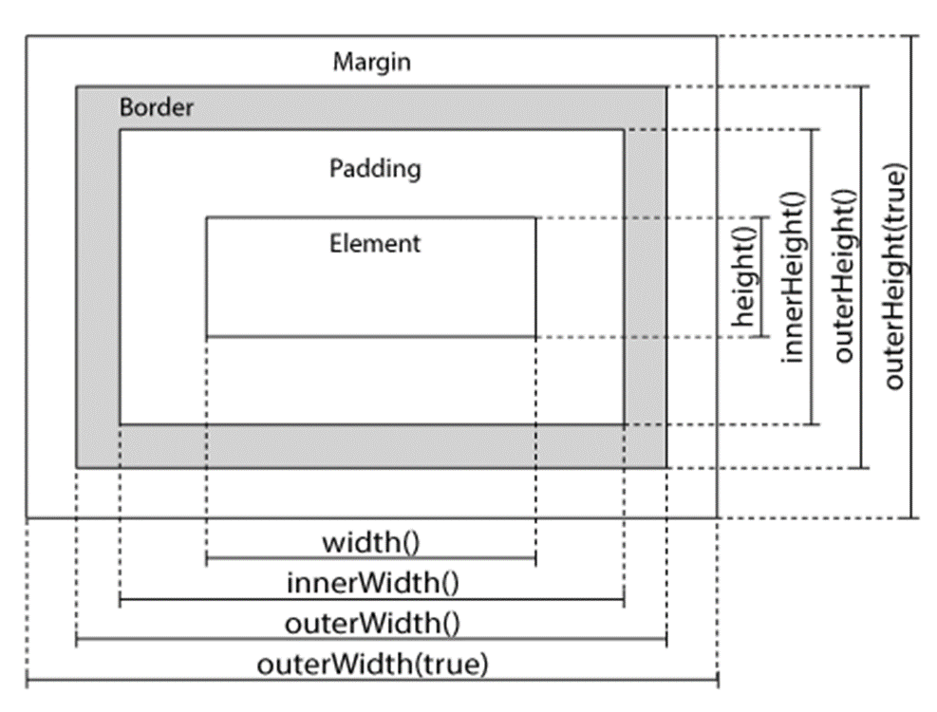
Dimensions
width()
height()
innerWidth()
innerHeight()
outerWidth()
outerHeight()

Slide 30
Traversing

Slide 31
Traversing
Concept of ‘walking through’ DOM objects.
Also known as ‘ranging’ in native JavaScript.
Somewhat similar to travelling from point A to point B in the shortest possible time.

Slide 32
Traversing
Traversing in The DOM Tree
siblings()
next()
nextAll()
nextUntil()
prev()
prevAll()
prevUntil()

Slide 33
Traversing
Basic Filtering
first()
last()
eq()

Slide 34
AJAX

Slide 35
AJAX
exchanging data with a server and updating parts of a web page - without reloading the whole page
AJAX = Asynchronous JavaScript and XML.

Slide 36
load()
loads data from a server and puts the returned data into a selected element
Syntax: $(selector).load(URL, [data, callback]);
URL - specifies the URL you want to load
Data - set of query string of key/value pairs to send along with the request
Callback – function to be executed after load() is completed

Slide 37
HTTP Request: Get
Get – requests data from a specified resource
Syntax: $.get(URL, callback);
Example:
$.get("demo.asp", function(data, status){
alert("Data: " + data + "\nStatus: " + status);
});

Slide 38
HTTP Request: Post
Post – submit a data to a specified resource
Syntax: $.post (URL, data, callback);
Example:
$.post("demo_test_post.asp",
{name: "Donald Duck", city: "Duckburg" },
function(data, status){
alert("Data: " + data + "\nStatus: " + status);
});

Slide 39
References
https://www.w3schools.com/jquery/
http://api.jquery.com/

